Slide 1
The Evolution of Samba Active Directory
Speeding up Samba by backing up
The team at Catalyst IT has been busy implementing quite a range of new features to Samba Active Directory. In doing so, there have been some unintended, but generally positive, consequences which have changed the way we have been developing new features. One such consequence has been from our new backup tools which has resulted in a huge improvement in our ability to test networks more reliably. Particularly at larger scales, it has made identifying performance issues significantly easier.
For users, these side-effects should also be appreciated like the potential for more reproducible lab networks, as we continue to build tools and features like Windows but a little differently (and maybe a little better).
This talk will go over some of the basics of the new backup and restore tools for AD domains, and cover some of the work that was done to make simple group policy objects (GPO) portable. It will also include some of the changes in how we have been doing testing and some of the impacts to the selftest system. Hopefully there'll be something interesting to everyone.
Experiences in implementing and optimizing Active Directory features in Samba
Garming Sam – Catalyst IT

Slide 2
What has been done in the last year?

Slide 3
Samba 4.9
Password and membership change auditing
LMDB back-end (semi-experimental)*
Fine grained password policies
Domain backup, restore and rename tools
Better DRS partner visualization
Automatic DNS site coverage*
DNS scavenging support*
Improved trust support and more...

Slide 4
Samba 4.10
GPO import and export*
KDC* and NETLOGON prefork (default in 4.11)
(Prefork) improvements for restarting services automatically
Changes to LDAP paged results to save memory*
Offline domain backup
Python 3 support
Audit logging with MS event IDs and more...

Slide 5
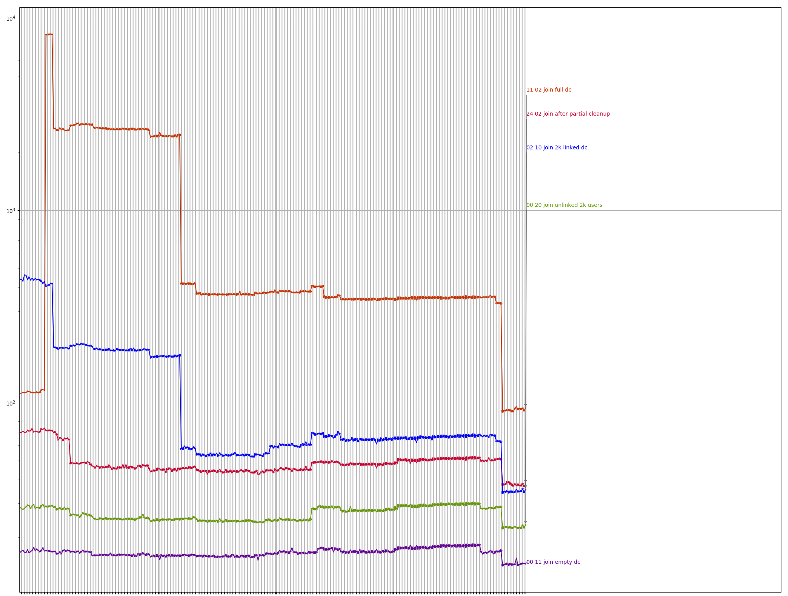
A content slide
Join

Slide 6
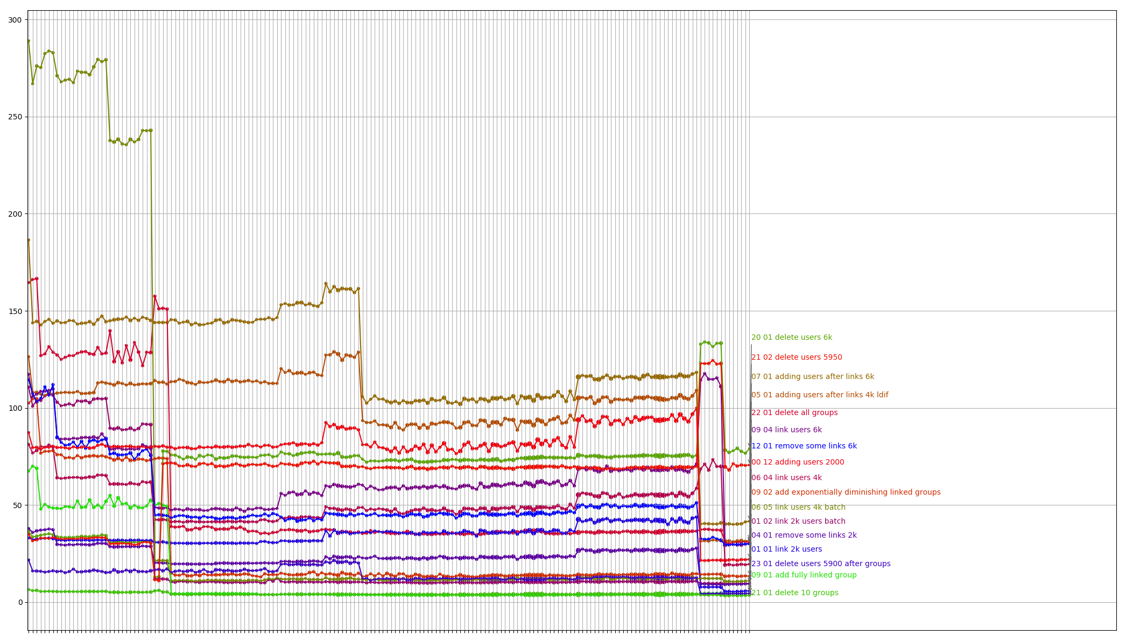
A content slide
Modify

Slide 7
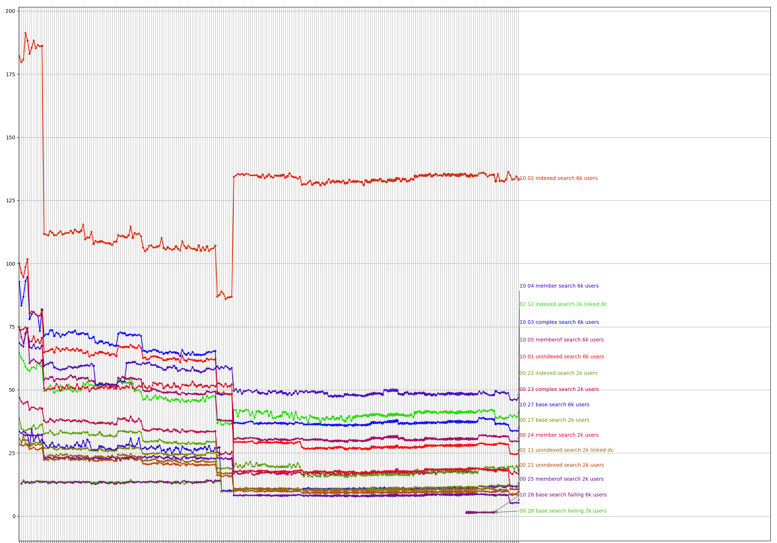
A content slide
Search

Slide 8
Performance, performance, performance
Replication improvements, linked attribute performance, rename performance, large scale improvements, ... as well as other things like schema updates

Slide 9
Traffic replay runner
Recording real network traffic and
playing it back at different speeds

Slide 10
Naive traffic runner results (2 vCPU, 8GB RAM)
v4.6 – 113 operations / second
v4.7 – 94 operations / second (changes to LDAP multi-process)
v4.8 – 154 operations / second (only in new prefork process mode)
v4.9 – 157 operations / second (only in prefork mode)
v4.10 – Same as 4.8 and 4.9
Git master (prefork is default) – about 165 operations / second
Traffic sample is largely DNS, name resolution, LDAP bind, NETLOGON (typical)

Slide 11
Basic steps for replaying traffic


Traffic model (optional)
Create a statistical model for generating proportionally similar traffic


Network trace
Run wireshark and get a pcap output
Traffic summary
Anonymize the traffic and
pick out important details
to replay
Or just on one slide
(Delete this point)

Slide 12
Basic steps for replaying traffic



Play traffic
Run either the summary or the model file
Analyze the results
Successes or failures,
median, mean, max, 95th

Slide 13
Basic steps for replaying traffic

That’s it!
We’re fast, 100,000 users, no problems!


Play traffic
Run either the summary or the model file
Analyze the results
Successes or failures,
median, mean, max, 95th

Slide 14
The real difference between Samba 4.9 and the upcoming 4.11
In particular environments, performance can degrade quickly based on database size:
Build | Users | Machines | T (pkts/sec) | Ops/sec | Latency
Master/v4.11 | 4,400 | 4,400 | 240 | ~165 | 4.78s
v4.9 | 4,200 | 4,200 | 228 | ~157 | 3.24s
Master/v4.11 | 50,000 | 62,500 | 196 | ~135 | 4.58s
v4.9* | 50,000 | 62,500 | ? < 80 | ? < 43 | 51.90s

Slide 15
The real difference between Samba 4.9 and the upcoming 4.11

Slide 16
The real difference between Samba 4.9 and the upcoming 4.11

Slide 17
How did we do it?
1. Created a new backup regime
2. Automated set-up of large domains
3. Periodic and targeted traffic replay

Slide 18
Domain backup
A new method of backing up an AD Domain in Samba 4.9 + 4.10
Work done for a separate client

Slide 19
Why?
Existing samba_backup script had a number of problems
  With a running DC it wasn’t certain to produce a valid copy
  It was safer than a standard copy, but didn’t respect lock ordering
  Might have caused deadlocks, corrupt or inconsistent (secrets) data
Single source of truth of the domain data (multi-master replication)
  Forcing a pristine backup to override corrupt data elsewhere is non-trivial
  Restoring into competing data, might look replicated due to old versioning
  Avoid some database inconsistencies by creating a replication (online) backup

Slide 20
Offline and online
DC
Database copy
Offline
Re-join DC
DC
DC
DC
Seed
RPC/
DRSUAPI
DC
Online
Network
EXAMPLE.COM
EXAMPLE.COM
samba-tool domain backup [online|offline]
Tar file
samba-tool domain backup restore
https://wiki.samba.org/index.php/Back_up_and_Restoring_a_Samba_AD_DC

Slide 21
Benefits
Reproducible testing is easier, upgrade testing is easier
Testing under different conditions is much easier
For those who re-deploy in a certain way, it’s the (almost) ideal tool
Still has issues from a user-perspective but very useful as a developer tool
Validating changes with large domains now becomes possible

Slide 22
Issues to resolve?
The tool doesn’t exactly replace samba_backup (despite being removed)
  samba-tool domain backup can’t restore to the same DC name
  samba-tool domain backup can’t restore to the same install location
  Copying of sysvol still seems buggy from the mailing list
For those who re-deploy in a certain way, it’s the (almost) ideal tool
For those who know to re-join or re-sync (often not perfectly but perhaps in cases where it isn’t that critical) it’s a new hassle
Backup of a domain, or backup of a domain controller?

Slide 23
Automation
Actually running the traffic runner
for real (making it reproducible
and periodic)

Slide 24
Automation
Virtual machines → cloud (sometimes too slow)
Openstack HEAT templates, Bash scripts
Ansible playbooks
Still has its problems, but we now have a mostly re-usable and composable set of playbooks (modules) for different AD environments using YAML files.
This work has led to upstream automation work, bootstrap code to simplify package installations across different platforms (more natural fit in the source tree).

Slide 25
Automation
DC
DC
DC

Slide 26
Automation
DC
RODC
DC
DC
DC
DC

Slide 27
Automation
DC
RODC
DC
DC
DC
DC
MACH
Seed AD domain from a backup

Slide 28
Automation
GUI → YAML
Backed by Docker or Vagrant instead of Openstack
How do we integrate the self-test system?
Can we use this infrastructure to run against Windows regularly?
Useful for development, probably overkill (or not a great fit) for production:
https://gitlab.com/catalyst-samba
ansible-role-samba-dc
ansible-role-samba-common

Slide 29
Linux Namespaces
Running under socket_wrapper (default test-bed for samba testing), we find a 10-20% performance hit when using LMDB.
Why not leave the network faking to the kernel?
Why not fake our hostnames and override DNS resolution using the kernel?
Completely isolated test-bed using ‘real’ network interfaces that can still be made to interact with the real system and virtual machines. Unfortunately still problems with UID fakery (apparently Docker is hard), but it works.

Slide 30
Replicating... forever
After joining a new domain controller to a restored domain,
ongoing replication would never end.
Why doesn’t it only take as long as the join (30 minutes)?

Slide 31
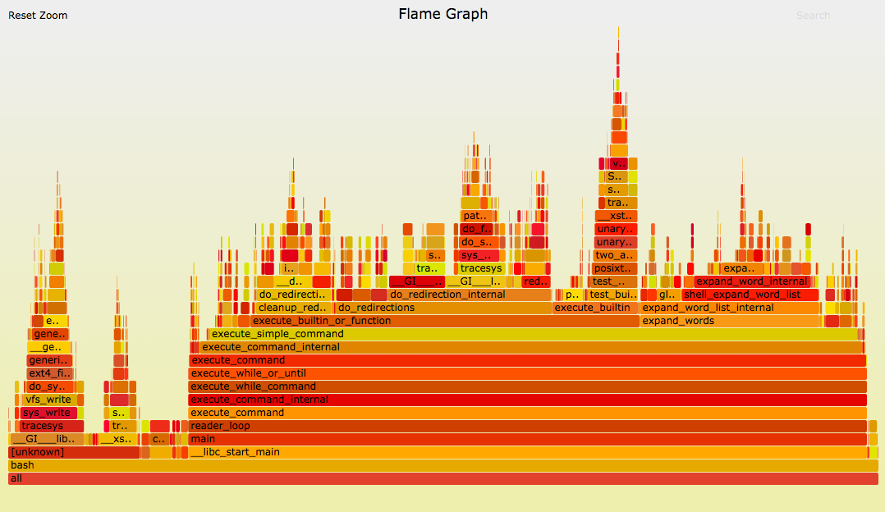
CPU Flame graphs
(Linux perf)

Slide 32
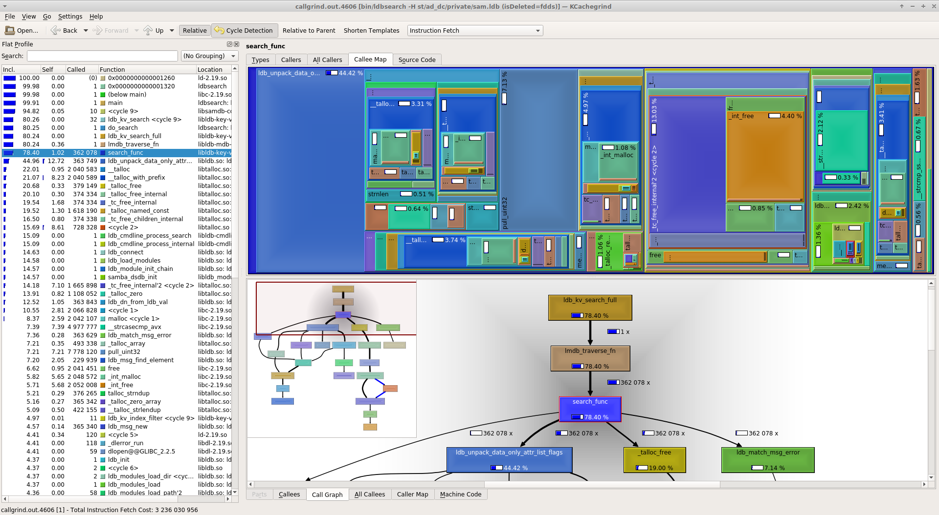
Callgrind

Slide 33
Print debugging
top (htop/iotop)
trial and error
basic arithmetic
gdb (attach to pid)
perf top
luck

Slide 34
Lessons
It turns out there was a bug in the backup code, but it found real performance issues that we then fixed
Accidentally doing the wrong thing means running out of memory quickly with a large database.
      Piecemeal growth ≠ dealing with everything at once
Learning how LMDB behaves - completely different to our previous database backend (copy-on-write)

Slide 35
Database changes motivated by our traffic statistics analysis
The effort required to improve figures to the degree shown in the upcoming 4.11 release

Slide 36
Changes to our database and core database services
Implemented indexing of >= and <= queries
Indexing 300,000 records went from ~4 sec to ~0.2 sec
Replication more responsive
  Example testing: ~4 sec to ~1 sec for no data, ~6 sec to ~1 sec for 200 new records
Paged results – Reducing required memory usage from GB to KB or MB
LDAP efficiency improvements – Impossible operations can now be done (search)
Subtree renames – Large renames from days to less than an hour

Slide 37
Changes to the database record storage format
CN=test_user,CN=Users
CN=test_user,CN=Users
2 elements
2 elements
name | 1 value | test_user
name | 1 | member | 5
member | 5 values
test_user
group_1, group_2
group_1, group_2
group_3
group_3
group_4, group_5
group_4, group_5
Only read data when necessary, offset data is stored at the beginning, massive size reduction.
Applies to more than just storage of group membership but also big blobs of data (e.g. photos).

Slide 38
2012 R2 Schema Support
Pre-requisite for 2012 R2 functional level and newer AD (security) features

Slide 39
2012 R2 schema support
First half (replication support) is already slated for 4.11
Second half (default schema) is currently waiting final sign-off and tweaks
Integration with newer Windows servers no longer causes ongoing replication problems and 2012 R2 servers can join Samba without issue now

Slide 40
GPO import/export
A new way of copying over a SYSVOL that functions across domains
Exports to XML with XML entities

Slide 41
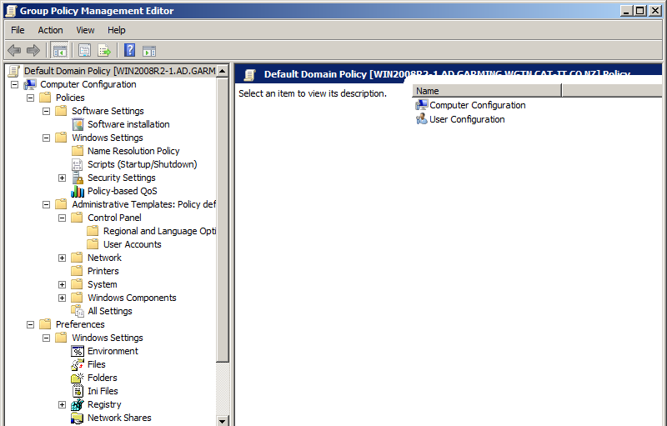

Slide 42
MS-GPOL
MS-GPOD

Slide 43
fdeploy1.ini
MS-GPOL
MS-GPOD
audit.csv
GptTmpl.inf

Slide 44
fdeploy1.ini
MS-GPOL
.xml
registry.pol
MS-GPOD
.aas
audit.csv
GptTmpl.inf

Slide 45
fdeploy1.ini
MS-GPOL
.xml
User/Documents & Settings
registry.pol
MS-GPOD
Machine/Microsoft/Windows NT/SecEdit
.aas
audit.csv
GptTmpl.inf

Slide 46
MS-GPNRPT
MS-GPFR
fdeploy1.ini
MS-GPWL
MS-GPOL
MS-GPSCR
.xml
User/Documents & Settings
MS-GPREG
registry.pol
MG-GPFAS
MS-GPOD
MS-GPAC
Machine/Microsoft/Windows NT/SecEdit
MS-GPSI
.aas
MS-GPDPC
audit.csv
GptTmpl.inf
MS-GPPREF
MS-GPSB
MS-GPIPSEC
MS-GPREF

Slide 47
Using GPO Import/Export
samba-tool gpo backup
samba-tool gpo restore
samba-tool gpo backup --generalize --entities=$OUT_PATH
samba-tool gpo restore --entities=$IN_PATH
<!ENTITY SAMBA____USER_ID_____7b7bc2512ee1fedcd76bdc68926d4f7b__ "Guest">
https://wiki.samba.org/index.php/GPO_Backup_and_Restore

Slide 48
Re-indexing
Example of an operation where our tooling failed and discovered improvements to join time of 2-4x

Slide 49
Re-indexing timings (mm:ss.ss)
100,000 users approx 230,000 records.
Hash size re-index time
1,000 14:42.06
10,000 1:59.56
100,000 39.92
200,000 37.48
300,000 43.16
50,000 users approx 110,000 records.
Hash size re-index time
1,000 3:46:93
10,000 37:29
100,000 18.95
20x improvement
Basically a one line change

Slide 50
Domain rename
Create testing environments and lab domains (without passwords and secrets)
Good for load testing an isolated network

Slide 51
Rename
DC
Re-join DC
DC
Rewrites to renamed.com
DC
Must supply new domain details in backup!
DC
RPC/
DRSUAPI
Seed
DC
Online
Network
RENAMED.COM
EXAMPLE.COM
samba-tool domain backup rename
Tar file
samba-tool domain backup restore
https://wiki.samba.org/index.php/Create_a_samba_lab-domain

Slide 52
Benefits and Caveats
Much less worries about production and pre-production interacting
Firewalling should be more straightforward
Experimenting with load and load testing different hardware
No explicit secrets (or close to it) isn’t anonymized or secret-free
The data in the domain means it can still serve the old DNS records
Rebuilding the sites and subnets is still a job on its own (automation?)
Use in production is debateable...

Slide 53
Traffic runner on a 50k user DC (with many links)
v4.9 – Targeting 80 operations / second (actual 32 success ops / second)
ldap 0 bindRequest 863 23 4.528840 0.563014 15.961734 203.778658 203.910120
Protocol Op Code Description Count Failed Mean Median 95% Range Max
Master – Targeting 80 operations / second (no failures + 2x throughput)
ldap 0 bindRequest 3450 0 0.505355 0.143523 2.496425 9.502704 9.546165

Slide 54
Traffic runner on a 50k user DC (with many links)
v4.9 – Targeting 80 operations / second (actual 32 success ops / second)
rpc_netlogon 39 SamLogonEx 1212 7 1.083997 0.458507 1.335286 60.024080 60.062607
Protocol Op Code Description Count Failed Mean Median 95% Range Max
Master – Targeting 80 operations / second (no failures + 2x throughput)
Master – Targeting 80 operations / second (no failures + 2x throughput)
rpc_netlogon 39 SamLogonEx 1568 0 0.082939 0.017412 0.091722 13.487989 13.493821
Some operations we emulate are silly in the large database case (or latency requirements).
Should try to improve 95% numbers, but this is a fairly worst case scenario with large groups.

Slide 55
Working with a (more realistic) 100k user DC
Doesn’t page the database into memory correctly, LDAP allocates 3x the database in memory (SSD recommended)
Loading into caches from memory can be extremely costly
(influencing the database binary storage format for 4.11)
LDAP bind doesn’t work pre–4.11 with users in a group of 100,000 users
Behaviour of sequential operations is not the same as in parallel
DNS???

Slide 56
Final takeaways
Real machines matter, fakery doesn’t measure performance (namespaces, docker, VM, bare-metal, modern hardware)
Measuring sequential operation also not helping (new tools?)
Repeating traffic runner runs (sys-admins should try it in a lab)
Reducing allocations helps in multi-process more than expected
(as well as other memory manipulations)

Slide 57
Final takeaways
We’ve been investing significant amounts of effort into more realistic testing
Normals tools and rules do not apply (to understand high load and concurrency)
Identified new areas for improvement (increase responsiveness, robustness and avoid issues arising in the future)
Important pieces (backup) that helped deliver the scale and breadth of performance improvements for 4.11 were funded by someone else

Slide 58
Thanks
...
→
garming@catalyst.net.nz
→
garming@samba.org
→
linkedin.com/in/garming-sam

Slide 59
Compress ODP file size
When you’ve finished your presentation, you can minimise the file contents to bring the file size down for storage or sending.
Click Tools → Minimize Presentation and select these settings at each step:
1. Projector Optimised
2. Tick ‘Delete unused master slides’ and ‘Delete hidden slides’
3. JPEG compression 75%, Reduce image resolution: 150dpi, tick ‘Delete cropped image areas’ and ‘Embed externals images’
4. Tick ‘Create static replacement images for OLE objects’ (you are unlikely to have any of these anyway)
5. ‘Apply changes to cuurent presentation’ OR ‘Duplicate presentation before applying changes’

Slide 60
Export slides to PDF

If you’re sending a presentation externally, you should always export your slides to PDF. This means your slides will be flattened and no longer editable.
If you don’t export to PDF, it’s highly likely that the recipient won’t be able to see or use the presentation font, and Font Awesome icons will appear as blank boxes.
After using Tools → Minimize Presentation you can select File → Export to PDF to output a multi-page PDF.

